Slide 1

It is very important that you stay as still as possible
during the experiment in the MRI machine.
.
If you need to move a bit or stretch, please do so between runs, when the scanner is not running.

Slide 2
Welcome The following presentation will guide you through how to respond to our rating scales.

Slide 3
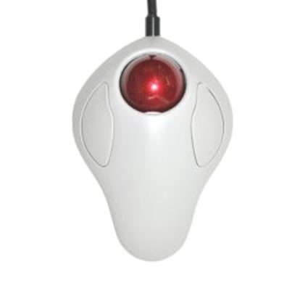
You have been given a trackball or an alternative response device in your dominant hand.

Slide 4

Spinning the trackball to the right will move rating indicators to the right-side of the scale, typically indicating an increase in your rating.

Slide 5
Spinning the trackball to the left will move rating indicators to the left-side of the scale, typically indicating a decrease in your rating.

Slide 6
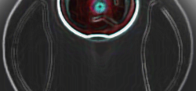
You may submit your response using the left button. Do not use the right button to submit a response.

Slide 7


What to Expect
Using the trackball in the scanner, you will be able to resize the triangle to indicate your rating.

Slide 8
What to Expect
How intense was this overall?
No Sensation: “I feel no sensation at all.”
Barely Detectable: “I could barely detect this sensation.”
Weak: “I feel that this sensation was weak.”
Moderate: “I feel that this sensation was moderate.”
Strong: “I feel that this sensation was intense.”
Very Strong: “I feel that this sensation was very intense.”
Strongest Imaginable Sensation of Any Kind: “This sensation was so intense that it is the worst I have ever experienced.”

Slide 9

This is an example of a scale rating comfort.
Once in the scanner you can use the trackball to resize the triangle and click to submit your rating.

Slide 10
How comfortable do you feel right now?
The thoughts I experienced during the last scan were negative. [yes/no]
Please rate how much you want to avoid this experience in the future?

Slide 11
Could you explain back to me how you understand the rating scale?

Slide 12
Intensity is how the song is.
Unpleasantness is how much you the song.
Please keep this distinction in mind when you're asked to rate the stimuli.
loud
dislike
Notes:
Consider this example when trying to understand the difference between intensity and unpleasantness. I can ask you to rate a song on how loud the song sounds or on how much you dislike hearing it
Intensity is how loud the song is and the unpleasantness is how much you dislike the song.
Please keep this distinction in mind when you're asked rate the stimuli. Do you have any questions?

